Slide 1
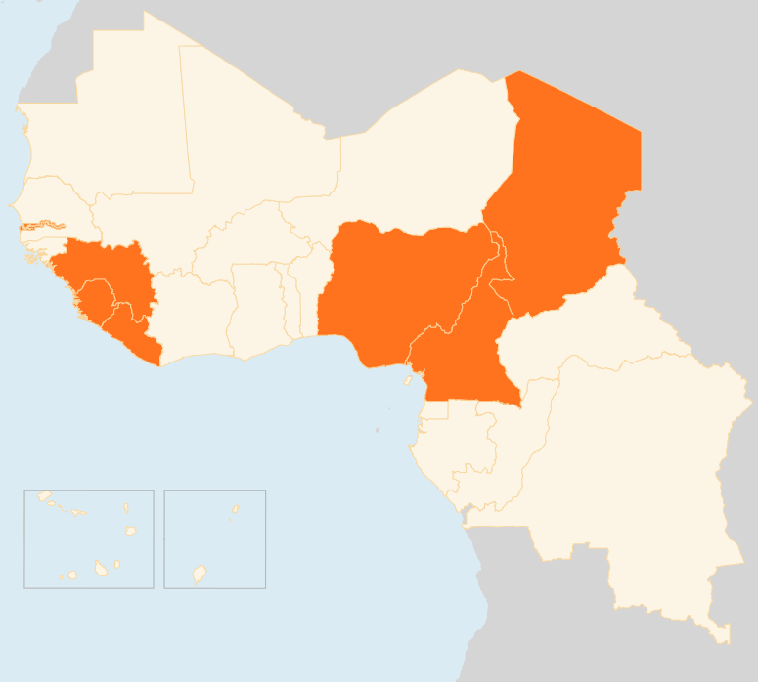


07 – 13 July 2015
CHAD
16 KILLED IN SUICIDE BLAST
On 11 July, at least 16 people were killed and dozens others injured when a suicide bomber blew himself up at the entrance of N’Djamena’s central market. The attack was the third of its kind in the capital city in less than a month. Dozens were also killed when attackers struck N’Djamena on 15 and 29 June. Separately, several attacks have been reported in recent days in the southern Lac Region in which around 30 people have died.
CAMEROON
11 KILLED IN TWIN SUICIDE ATTACKS
On 12 July, 11 people were killed in two suicide bombings in Fotokol, a town in Cameroon’s Far North Region near the border with Nigeria when two burqa-clad assailants detonated suicide belts - one in a public space where people often gather to break the Ramadan fast and the other outside a military camp. The suicide blasts were the first of their kind in Cameroon, which has been repeatedly targeted by Boko Haram militants. Two days before the bombings, the town had come under rocket attack that killed one person.
LIBERIA
SECOND EBOLA DEATH REPORTED
A second Ebola patient died on 12 July on arrival at an Ebola treatment centre in the capital Monrovia. The first EVD death in seven weeks since Liberia was declared Ebola-free occurred on 28 June. A total of six confirmed cases, including the two deaths have so far been reported. The source of transmission for the current outbreak is still under investigation.
NIGERIA
SLIGHT DROP IN IDP NUMBERS
As of June 2015, there were 1,385,298 IDPs in Nigeria’s north-eastern states of Adamawa, Bauchi, Borno, Gombe, Taraba and Yobe, according to the June update of the Displacement Tracking Matrix by IOM and Nigeria’s National Emergency Management Agency. The figure marks a slight decrease compared to the last update in April when some 1.5 million IDPs were identified. The drop is due to movements of return observed on the ground, especially in Adamawa where the IDP population has decreased by 49 percent. In contrast, in Borno, the IDP population has increased since April and is now over a million (1,002, 688).
EVD REGIONAL
25 NEW CASES REPORTED
Guinea reported a total of 13 new confirmed cases, of which seven were in Conakry, as of 13 July. Meanwhile, humanitarian actors launched a sensitisation campaign in Benty locality of Forécariah, one of Guinea’s four Ebola hotspot prefectures. In Sierra Leone, eight new cases were reported as of 12 July. An enhanced health intervention in the country’s Ebola hotspots in the northwest has been extended for 90 days to the first week of October. In the week leading up to 5 July, there were 30 confirmed cases in the three countries, marking the highest weekly total since mid-May.
CHAD
16
NIGERIA
KILLED IN SUICIDE BLAST
1.4M
IDP NUMBERS DROP
CAMEROON
11
KILLED IN SUICIDE ATTACK
EVD REGIONAL
LIBERIA
25
NEW CASES
2
EVD DEATHS RECORDED
Creation date: 15 July 2015
Map data sources: UNCS, DevInfo, OCHA.
The boundaries and names shown and the designations used on this map do not imply official endorsement or acceptance by the United Nations

